Slide 1

Removal of Batch Effects with Matched Mutual Nearest Neighbors in Single-cell RNA Sequencing data
Fall Lab Rotation
Jessie Tong
Advisor: Prof. Mingyao Li
1:15–1:30 PM 12/04/2019

Slide 2
Background
In human body, there exists incredible diversity in cell types across human tissues.
Researchers want to investigate the mechanisms that give rise to this diversity in development and how they develop into disease
https://www.anatomynote.com/human-anatomy/cell-and-tissue/human-body-cell-classification/

Slide 3


Background (cont.)
Understanding of cells are driven by new approaches of observing and measuring.
Technological innovations allow researcher study the cells at increasing resolution.

Slide 4
Introduction
Single-cell RNA sequencing data (scRNA-seq)
allow us to study the cells at a high resolution
widely used for transcriptome analysis in many areas of biology
provides quantitative measurements of the expression of every gene in a single cell
https://www.lcsciences.com/discovery/applications/transcriptomics/single-cell-rna-seq-sequencing-service/

Slide 5
Batch effect
One of the most challenging problems in single-cell RNA sequencing data
Induced when large-scale single-cell RNA sequencing data sets are produced:
With different technical sources
In different laboratories
At different times
Expression of genes in one batch different from that in another batch
Notes:
Such differences can mask underlying biology in the data; thus, to avoid misleading conclusions, they must be corrected before further analysis.

Slide 6
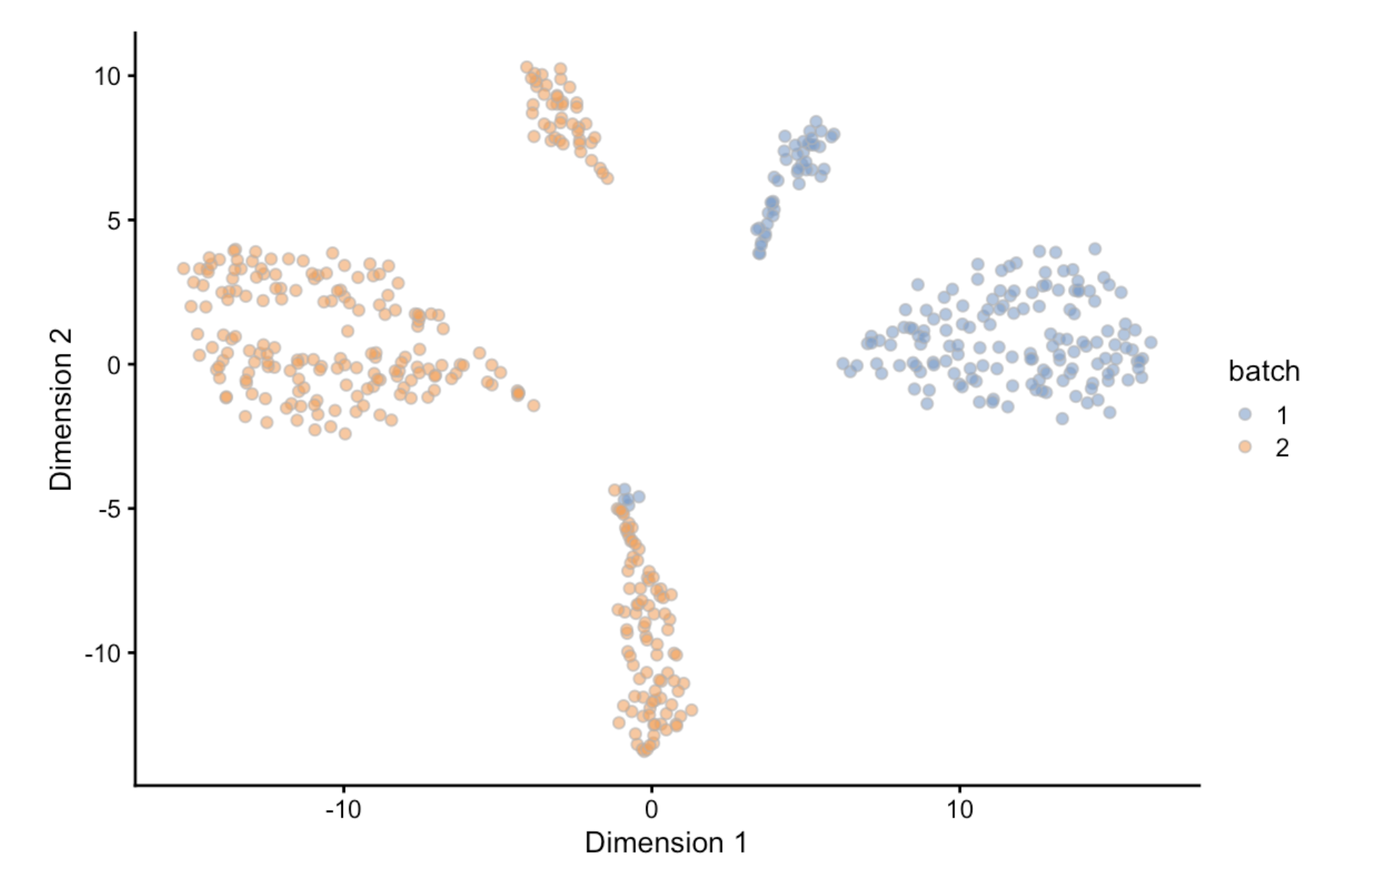
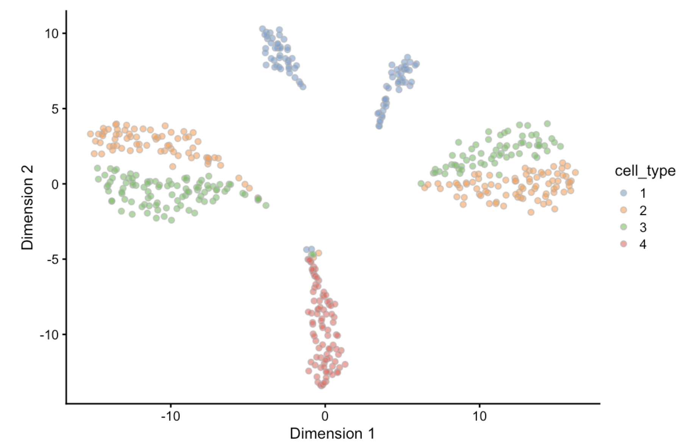
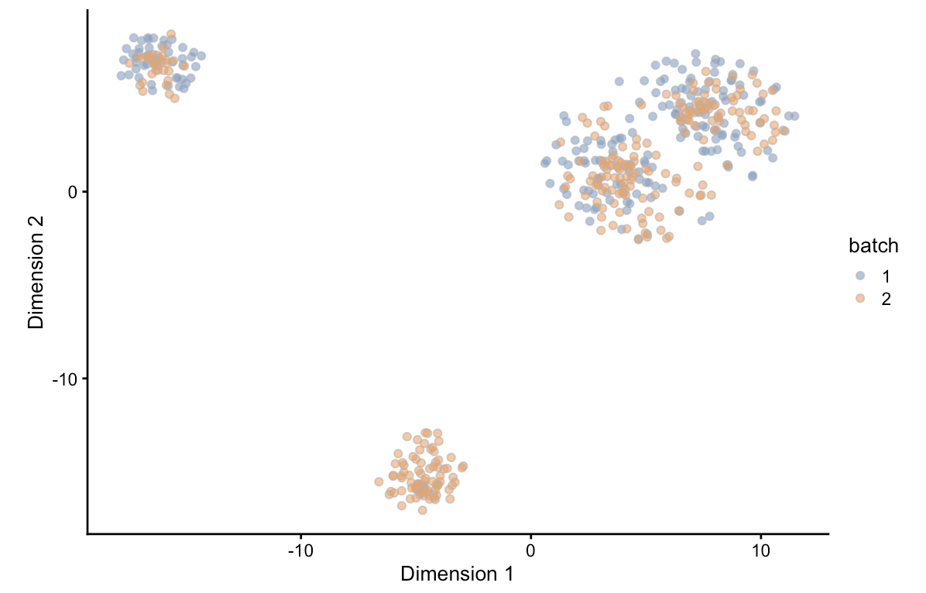
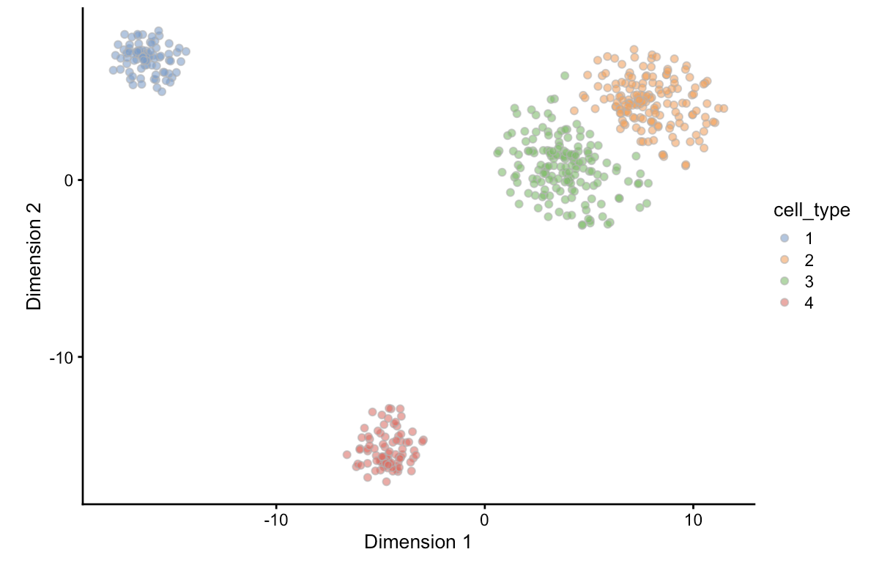
Batch effect (cont.)
Before correction
After correction
Notes:
The TSNE plot is a dimensionality reduction technique which is a way to graphically simplify very large datasets. Theere is no meaning for the x- and y- axis, but the circle here is meaningful.
Each circle represent a cell and if the cells are from the same population, there will form a cluster for the cell.

Slide 7
Existing methods
removeBatchEffect() function in limma package
ComBat method
RUVseq
Svaseq
HOWEVER, most existing methods for batch correction were specifically designed for bulk RNA-seq.

Slide 8
MNN method
Haghverdi et al. proposed a matching mutual nearest neighbors (MNN) method to conduct batch correction for single-cell RNA sequencing data in 2018
One of the most popular methods
214 citations
Removal of discrepancies between biologically related batches according to the presence of MNNs between batches
Define the most similar cells of the same type across batches
Difference in expression values between cells in an MNN pair provides an estimate of the batch effect
A correction vector is obtained from the estimated batch effect and applied to the expression values to perform batch correction
Notes:
Each cell can be eexp

Slide 9
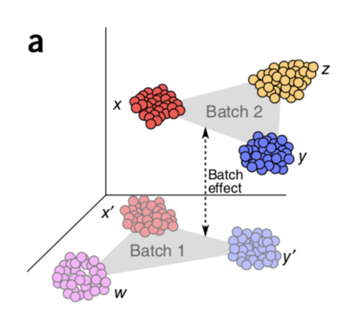
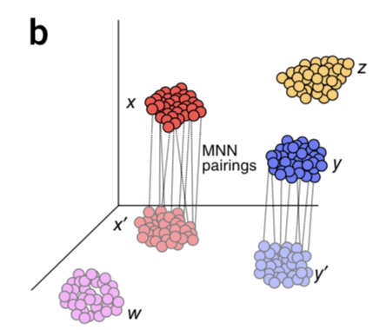
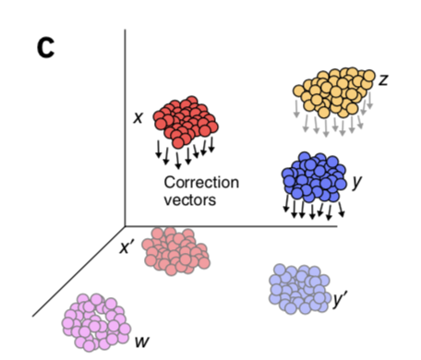
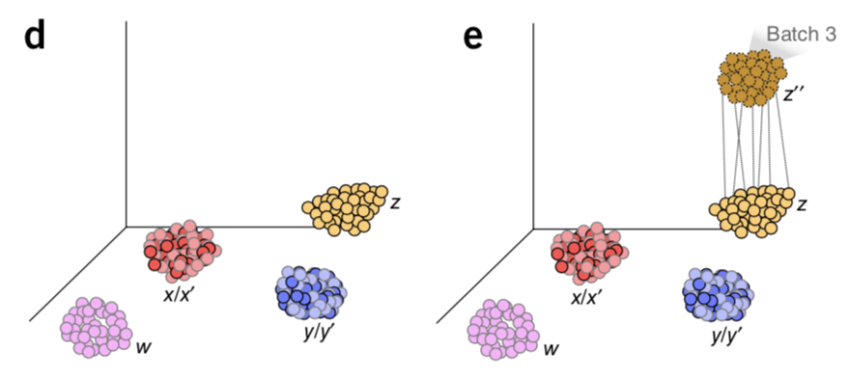
MNN method (cont.)
Notes:
Each cell has expression vector (can be expressed as a vector of 0, 1, . If the one gene is expressed, then the value of that gene is 1.)
Schematics of batch-effect correction by MNN. (a) Batch 1 and batch 2 in high dimensions with an almost orthogonal batch effect difference between them. (b) The algorithm identifies matching cell types by finding MNN pairs of cells (gray box). (c) Batch-correction vectors are calculated between the MNN pairs. (d) Batch 1 is regarded as the reference, and batch 2 is integrated into it by subtraction of correction vectors. (e) The integrated data are considered the reference, and the procedure is repeated for integration of any new batch.

Slide 10
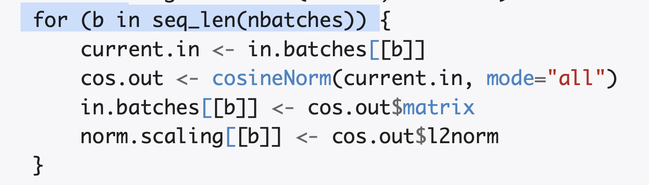
Limitation of MNN method
HOWEVER, one limitation we observed is that the order of pairwise matching two batches to get the MNN pairs is not clarified in the paper.
Source R code of mnncorrect() function:

Slide 11
Objective
Therefore, we would like to conduct a simulation study to explore the possible limitation we observed.
We would like to study if the order of the batches used to get MNN pairs would make an impact on the results.
Specifically,
Create several batches (e.g., four batches)
Each batch has different numbers of cell types (e.g., 3, 4, 5, 7)
Treat each batch as reference
Compare all the possible pairwise combinations of the batches
There are 24 possible combinations (e.g., c(1,2,3,4), c(3,2,1,4), c(4,3,1,2))

Slide 12
Simulation Study Design
Batch 1
Batch 2
Batch 3
Batch 4
Week 0
Week 8
Week 16
Week 24
1
1
1
1
2
3
2
3
2
3
2
3
Batch effect
Batch effect
Batch effect
4
4
5
4
5
6
7
Notes:
4 and 5 are the same cell populations

Slide 13
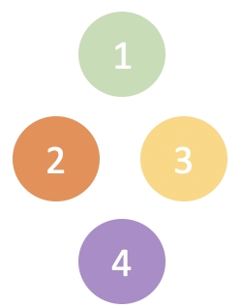
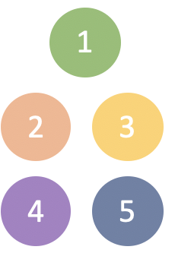
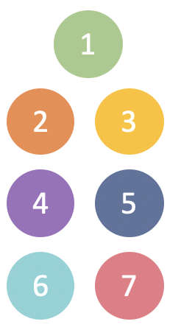
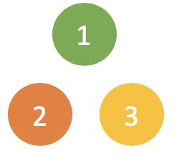



Simulation Study Design (cont.)
Expected to see in the clustering step:
Without batch correction, there will be 3+4+5+7 = 19 clusters.
With batch correction, we will get only 3+1+1+2 = 7 clusters.
+
+
+
+
+
+

Slide 14
Simulation Study Design (cont.)
Ce
Batch 1
Batch 2
Cell Type 1
Batch 3
Batch 4
Week 0
Week 8
Week 16
Week 24
 | Cell 1 | Cell 2 | Cell 3 | Cell 4 | Cell 5 | … | Cell n1
Gene 1 | 0 | 0 | 0 | 0 | 0 | … | 0
Gene 2 | 1 | 1 | 1 | 1 | 1 | … | 1
Gene 3 | 1 | 0 | 1 | 1 | 1 | … | 1
Gene 4 | 0 | 1 | 1 | 0 | 0 | … | 0
Gene 5 | 0 | 0 | 0 | 0 | 1 | … | 0
… | … | … | … | … | … | … | …
Gene 500 | 1 | 1 | 1 | 0 | 1 | … | 0
1
2
3

Slide 15
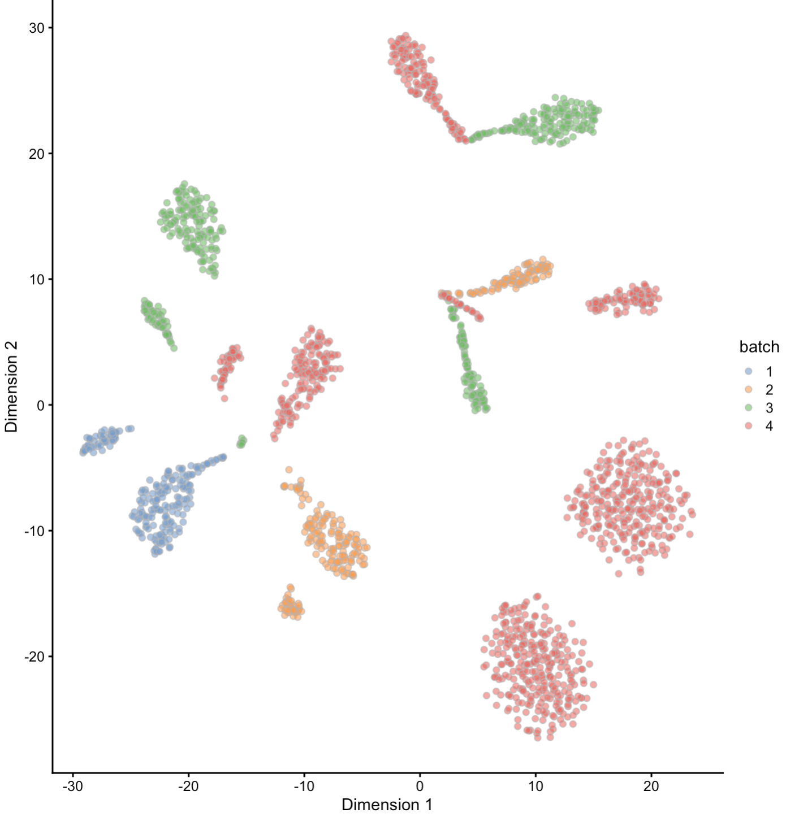
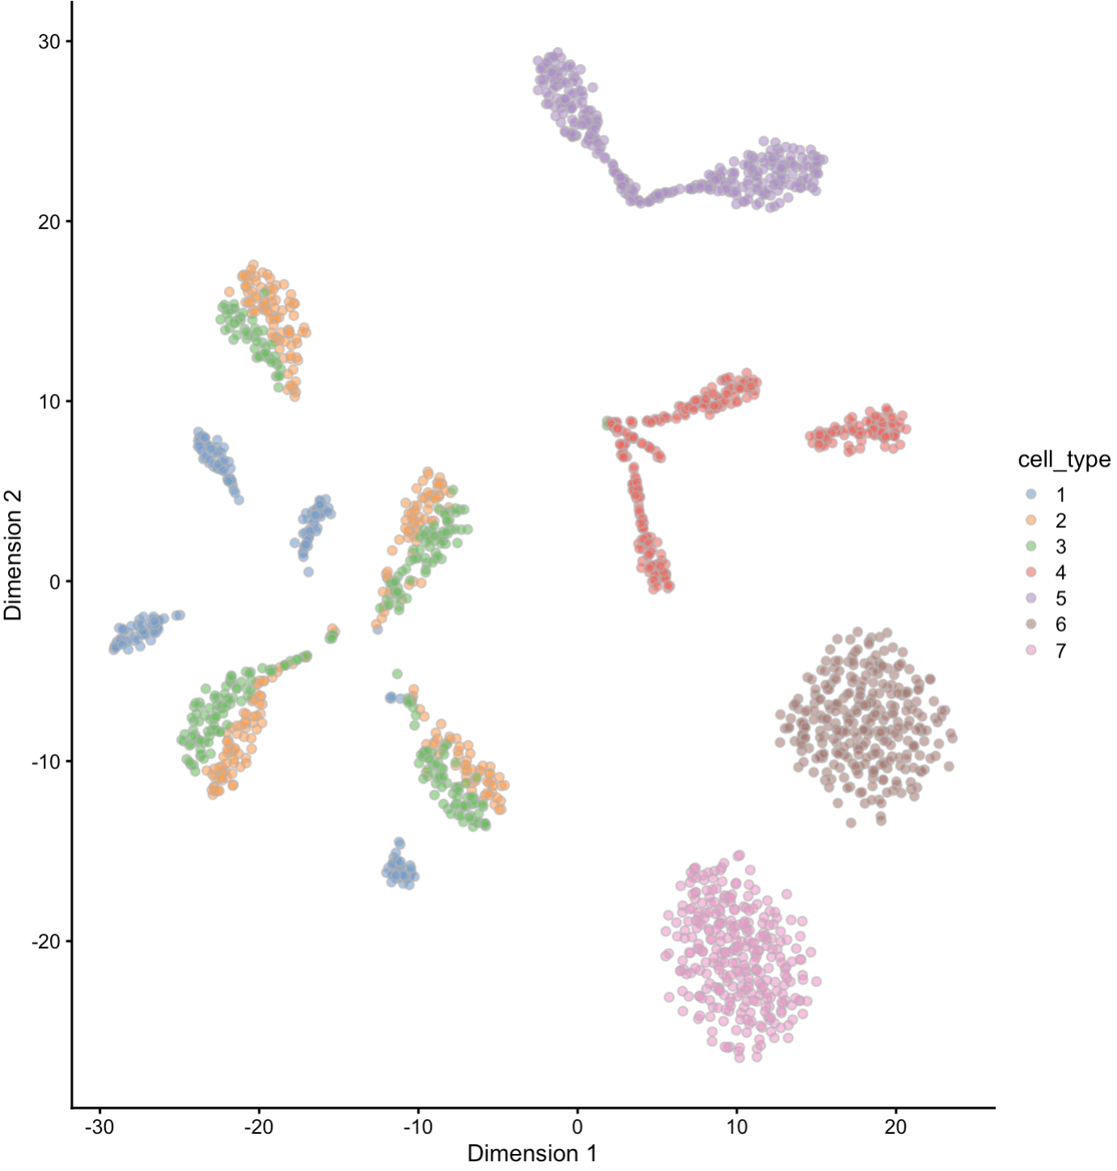
Simulated Data

Slide 16
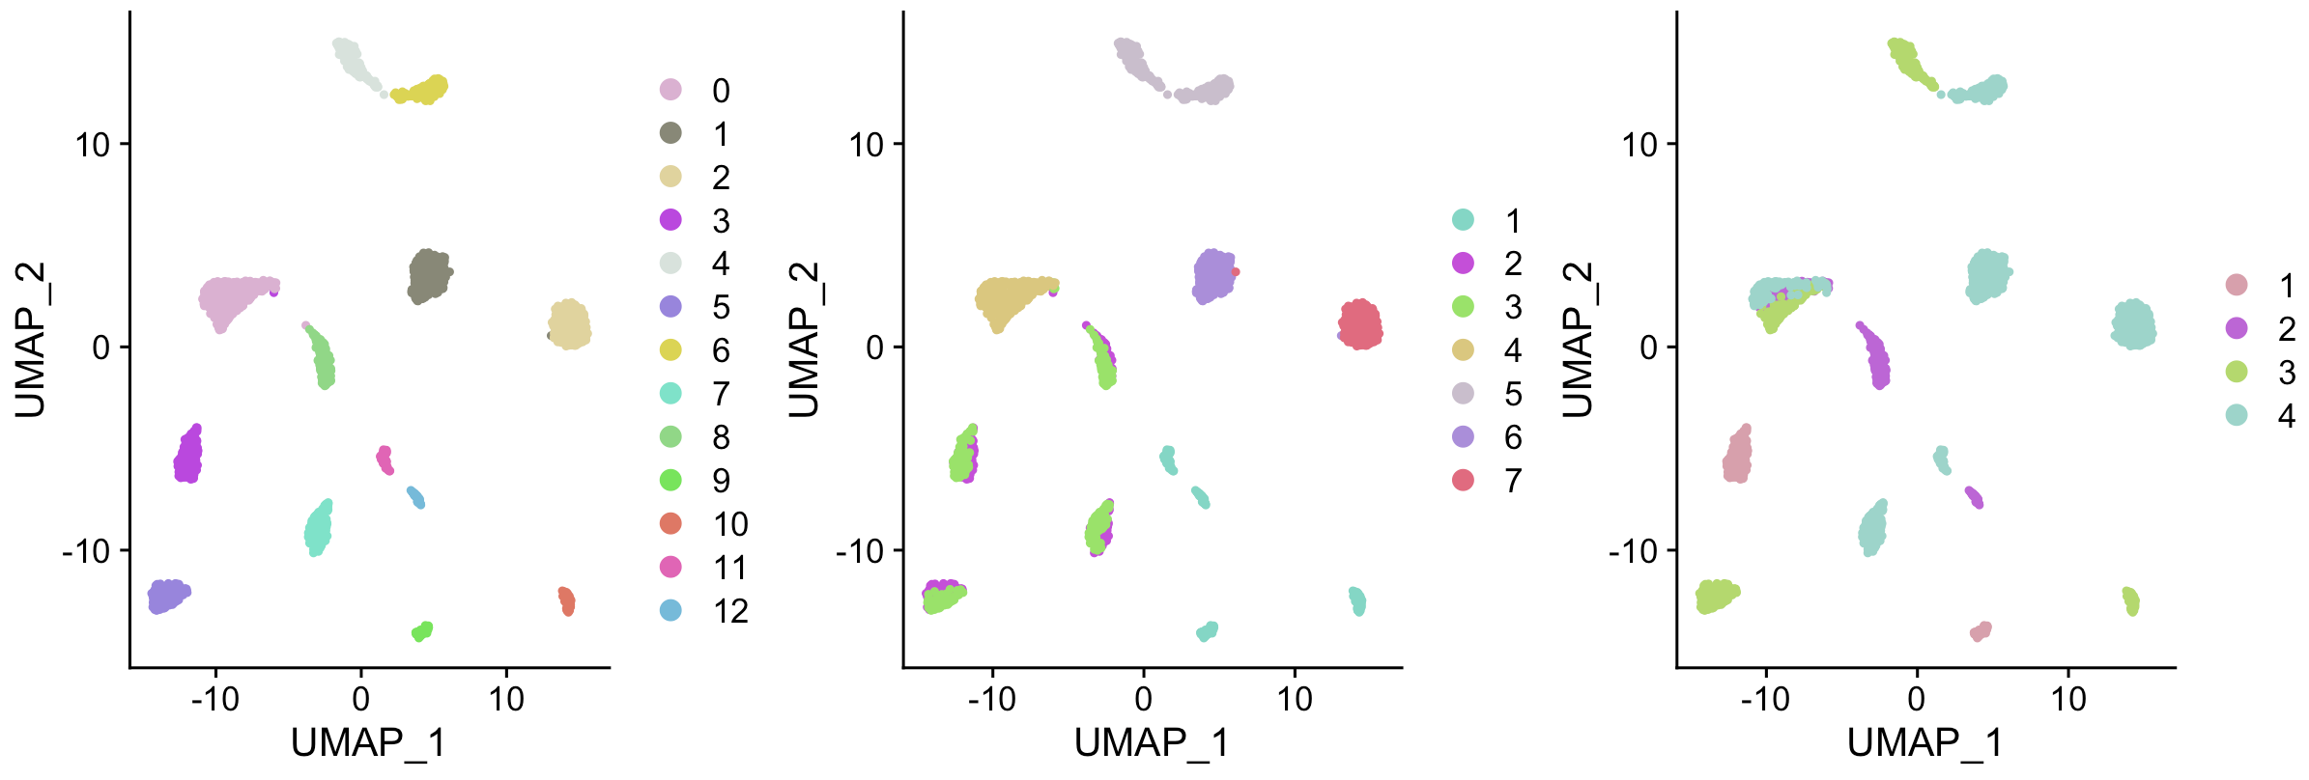
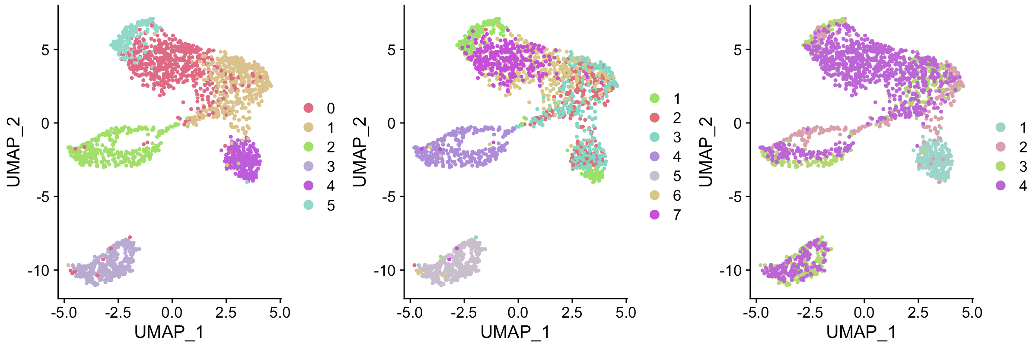
Results of Batch correction
Clustering results
True cell types
Batch
Before correction
After correction
Notes:
UMAP plot is similar to T-SNE plot but an improved technique to visualize the high-dimensional data into low dimension

Slide 17
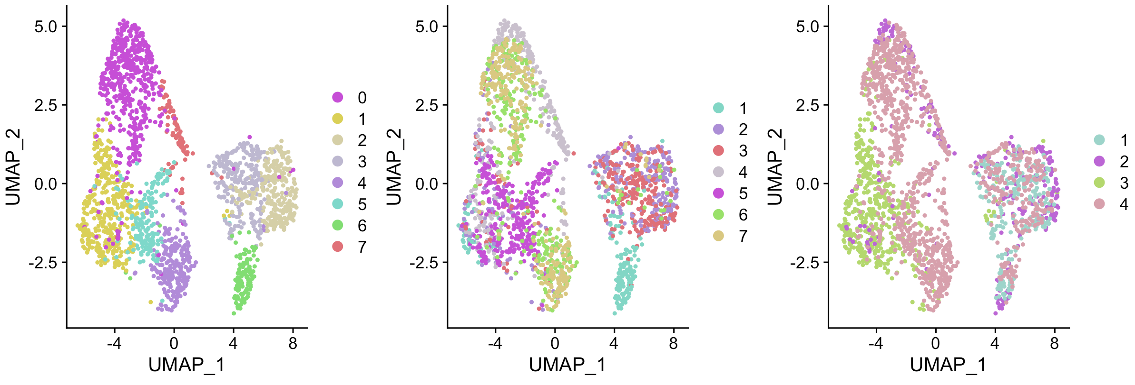
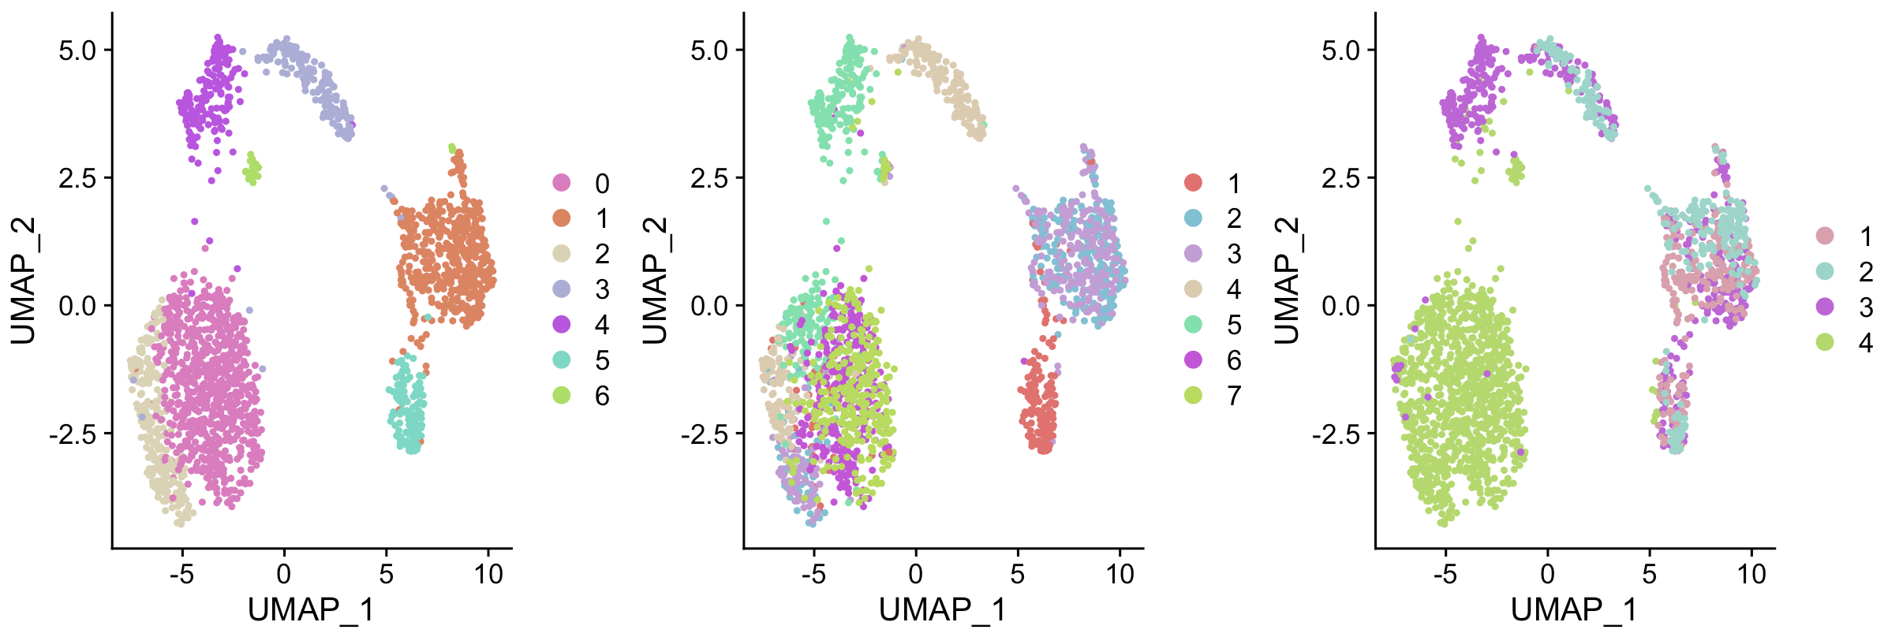
Results of different orders
ARI
(average rate index)
Order 1 (1,2,3,4)
0.52
Order 2 (3,2,1,4)
0.41
Order 3 (4,3,1,2)
0.33
Notes:
What figures to present? Do we need to present the Tsne plot & clustering analysis results both?
Show
UMAP (***explain this)
comparing two classifications from a contingency table. ARI >= 0.90 excellent recovery; 0.80 =< ARI < 0.90 good recovery; 0.65 =< ARI < 0.80 moderate recovery; ARI < 0.65 poor recovery.

Slide 18
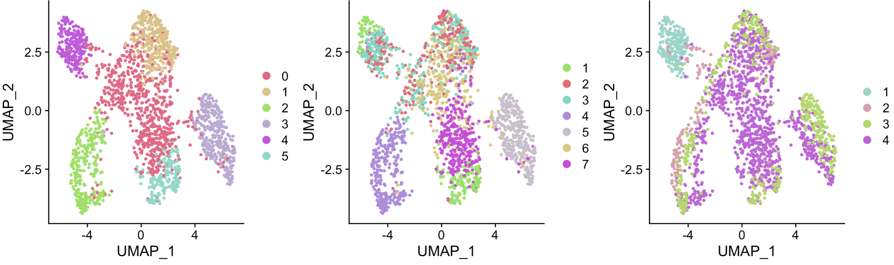
Results of different orders
ARI
(adjusted rank index)
Order 1 (1,2,3,4)
0.52
Order 4 (1,2,4,3)
0.47
Notes:
What figures to present? Do we need to present the Tsne plot & clustering analysis results both?
Show
UMAP (***explain this)

Slide 19
Quantified the differences
Corrected matrix for Order 1
Corrected matrix for Order 2
 | Cell 1 | Cell 2 | Cell 3 | Cell 4 | Cell 5 | … | Cell 2000
Gene 1
Gene 2
Gene 3
Gene 4
Gene 5
…
Gene 500
 | Cell 1 | Cell 2 | Cell 3 | Cell 4 | Cell 5 | … | Cell 2000
Gene 1
Gene 2
Gene 3
Gene 4
Gene 5
…
Gene 500
Correlation
Correlation

Slide 20
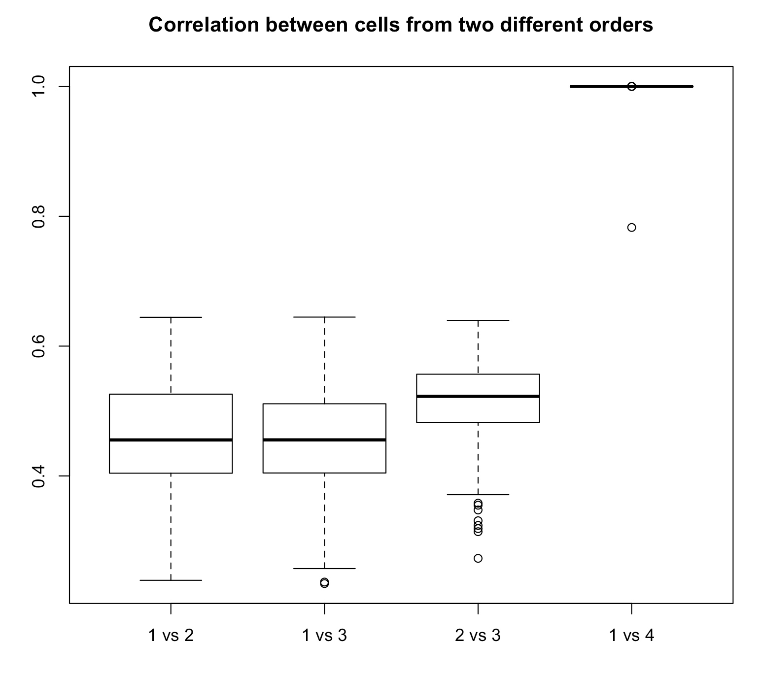
Quantified the differences (cont.)
Order 1 (1,2,3,4)
Order 2 (3,2,1,4)
Order 3 (4,3,1,2)
Order 4 (1,2,4,3)
Notes:
What figures to present? Do we need to present the Tsne plot & clustering analysis results both?
Show
UMAP (***explain this)

Slide 21
Conclusion & Discussion
Orders of the batches in MNN approach affect the results for batch effect correction.
When apply the MNN approach to correct batch effect in single-cell RNA sequencing data, researchers should be careful about the orders of the batches if the number of batches is larger than 2.
Since there is no natural order of the batches in reality, researchers should consider of simultaneous batch effect correction across all of the batches instead of pairwise correcting the effect.

Slide 22
Acknowledgement
Dr. Mingyao Li
Michelle Lee

Slide 23
References
Haghverdi, Laleh, et al. “Batch effects in single-cell RNA-sequencing data are corrected by matching mutual nearest neighbors.” Nature biotechnology 36.5 (2018): 421.
Zhang, Xiuwei, Chenling Xu, and Nir Yosef. “Simulating multiple faceted variability in single cell RNA sequencing.” Nature communications 10.1 (2019): 2611.

Slide 24


